Slide 1
Creating and Deploying AI Solutions in Minutes
For: startups, scaleups, solopreneurs, and enterprises
2024

Slide 2
Introduction
Problem statement:
I am an English publisher and I want to create audio summaries of my books in English, Turkish, Spanish, and French.
How long would it take to create such a solution?
Which technologies do I need?
Where can I source these technologies?

Slide 3
Demo
https://platform.aixplain.com

Slide 4
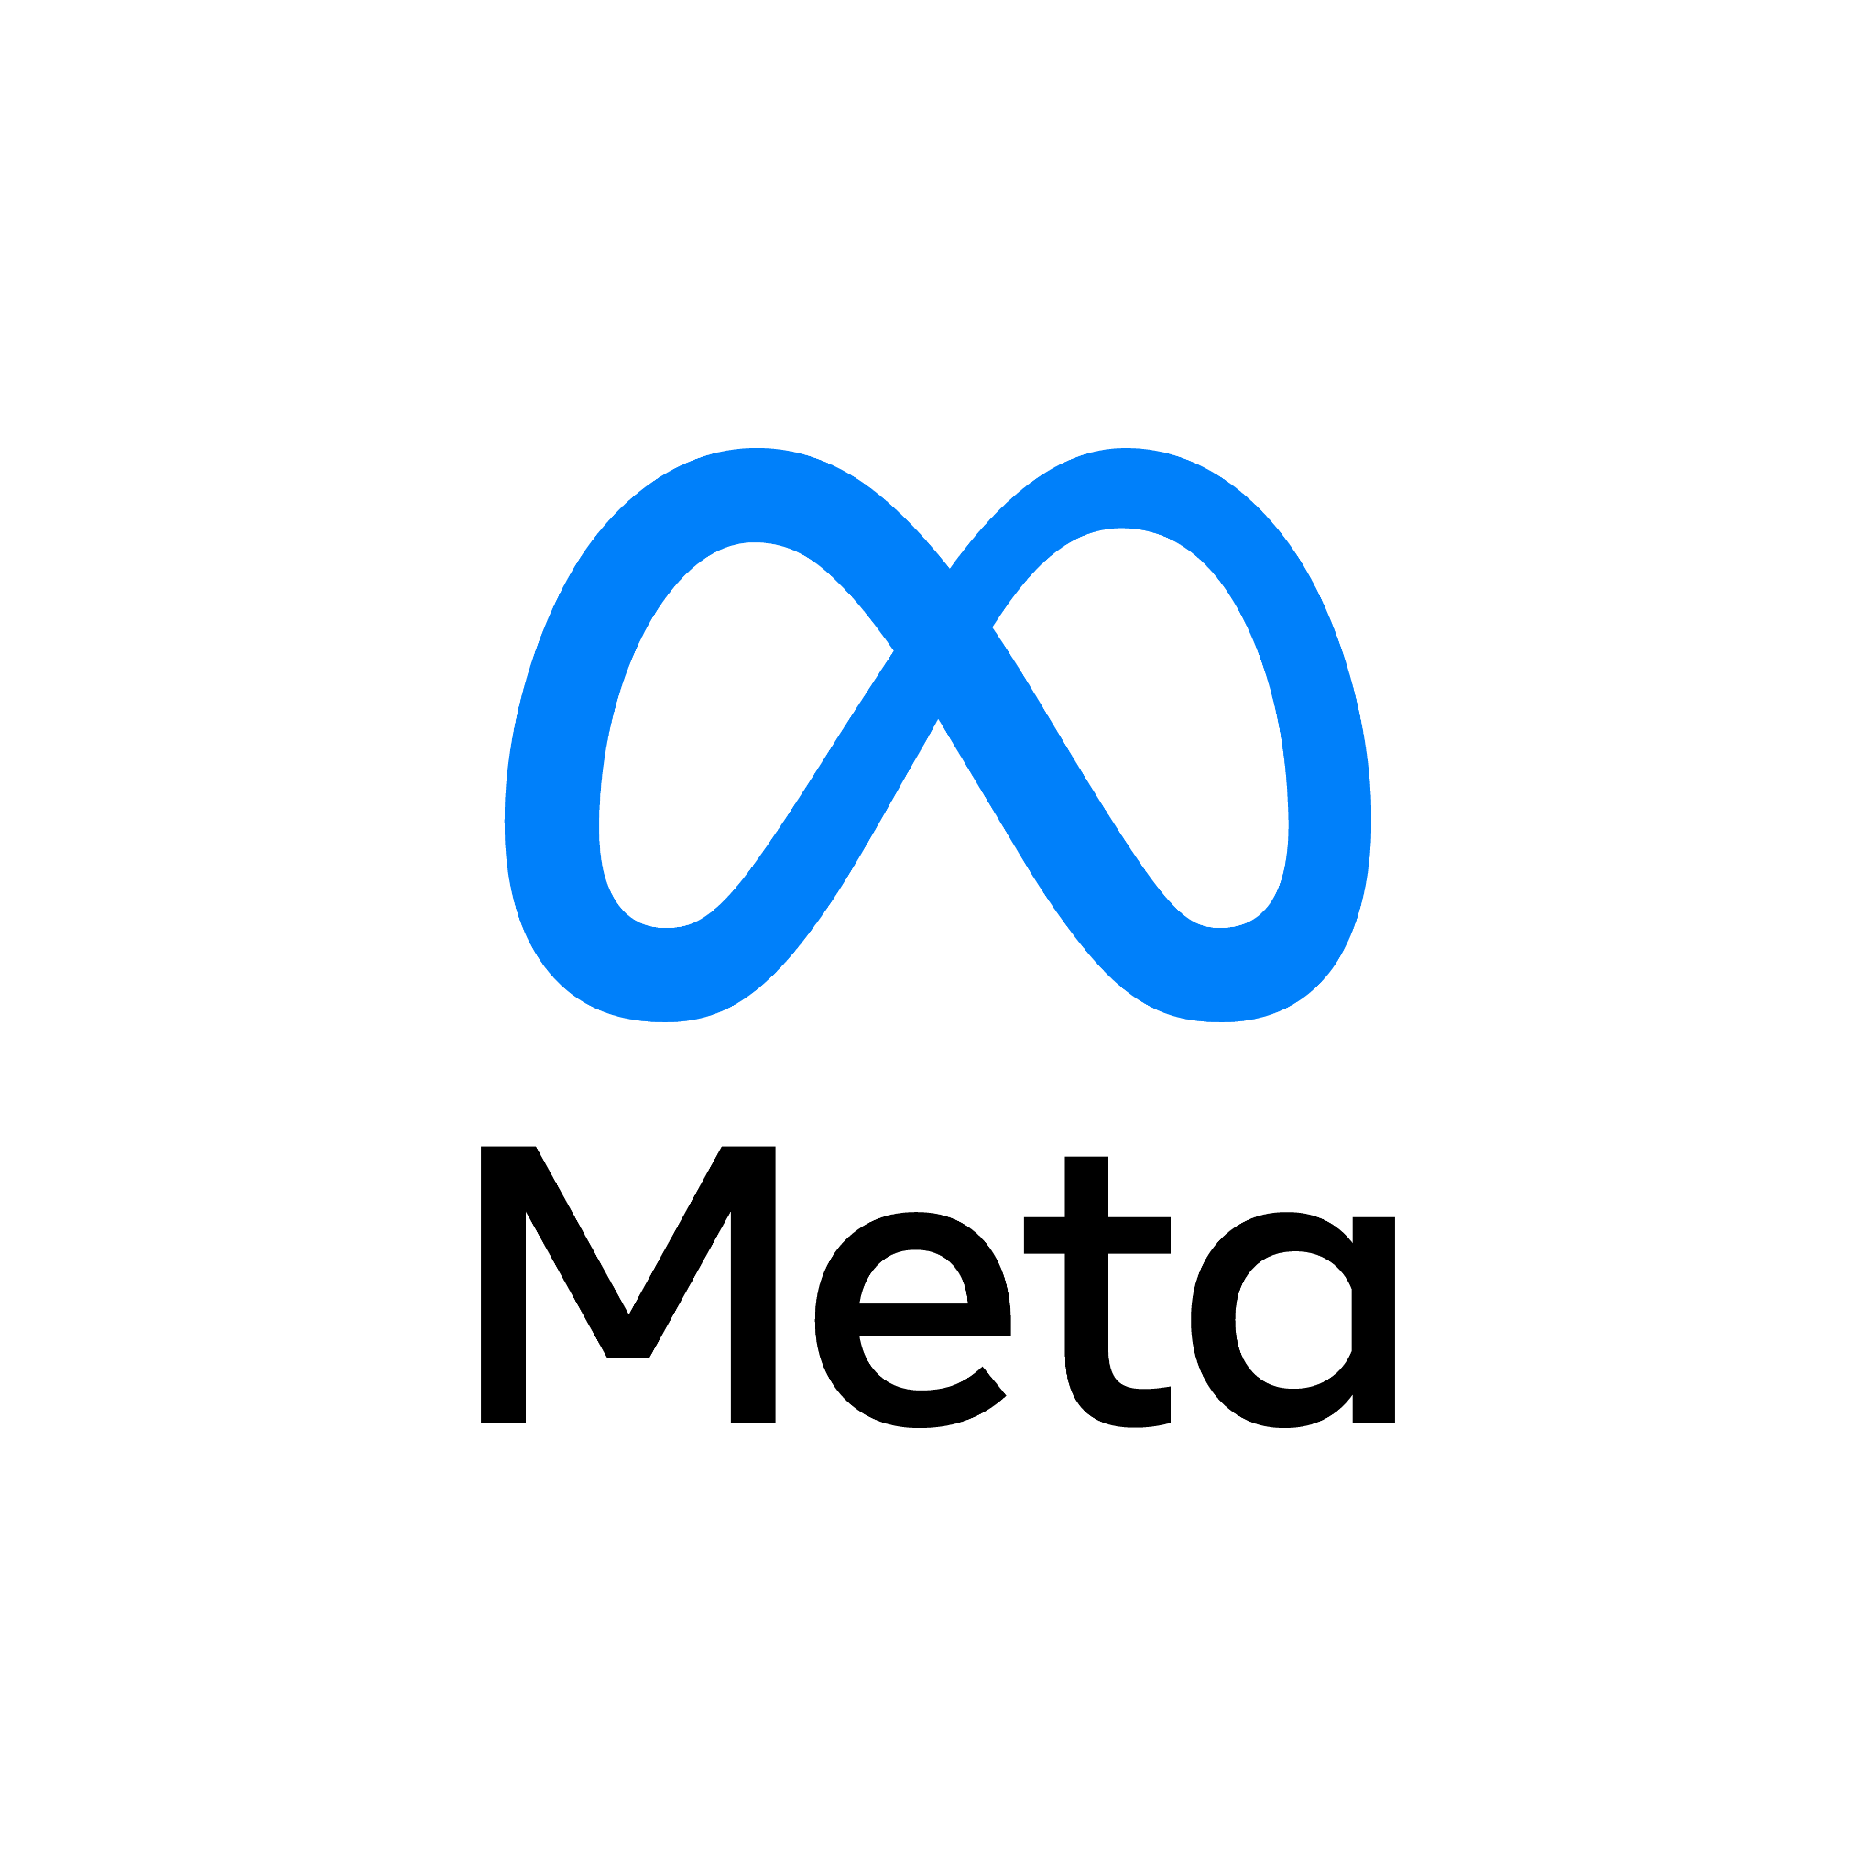
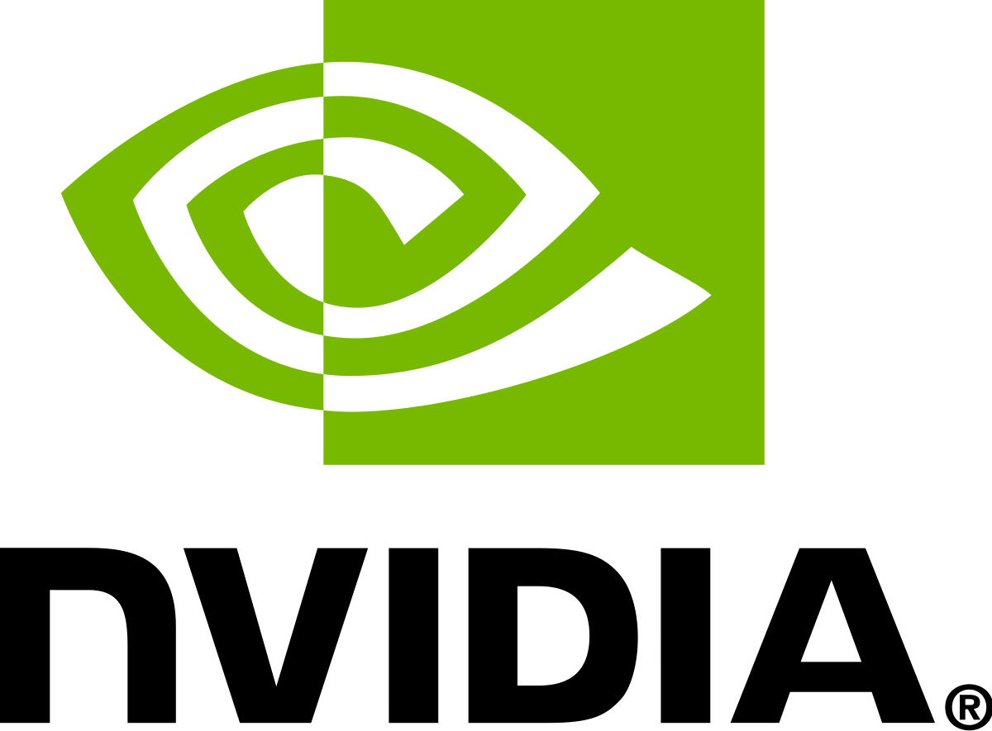
Platform Overview
aiXplain offers an end-to-end AI solution development platform with an integrated marketplace that takes its users from ideation all the way to deployment in a seamless no-code/low-code user friendly interface.
Discover
Design
Benchmark
FineTune
AutoMode
Marketplace of 40,000+ AI assets
Standardized APIs
Open-source and proprietary
No-code/low-code AI solution building
Drag, Drop, and Connect
Deploy in minutes to a single API
Swap models inside a solution seamlessly
Easy and fast way to evaluate model performance
Accurate, comprehensive, and interactive report
Granular insights on cost, quality, and latency, and bias
Customize pre-trained models by tuning it using your data
Set up and start in seconds
Logs to monitor the convergence of the training process
Create the best system to process your data on a segment level
Each segment is priced based on the system that processes the data
Benchmark

Slide 5
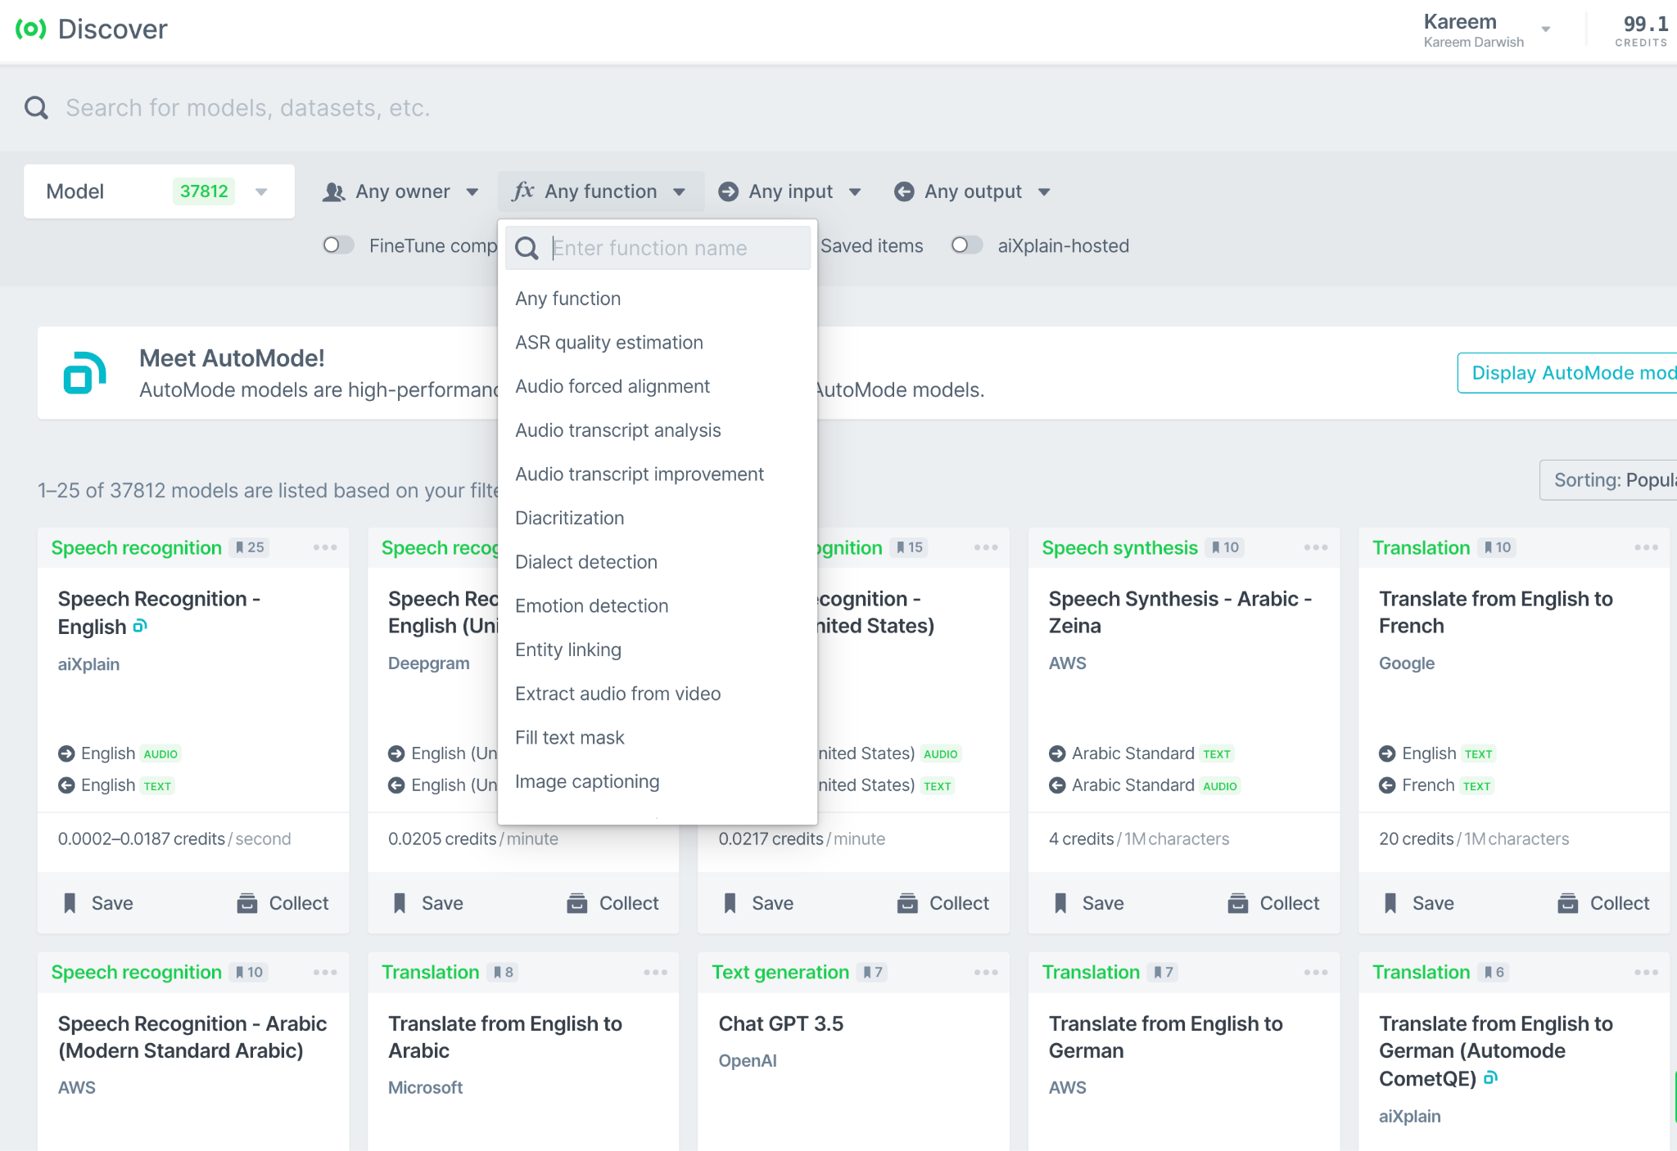
Platform Overview
Discover
Marketplace of 40,000+ AI assets
Open-source and proprietary
Dozens of different functions
Standardized API for ALL models

Slide 6
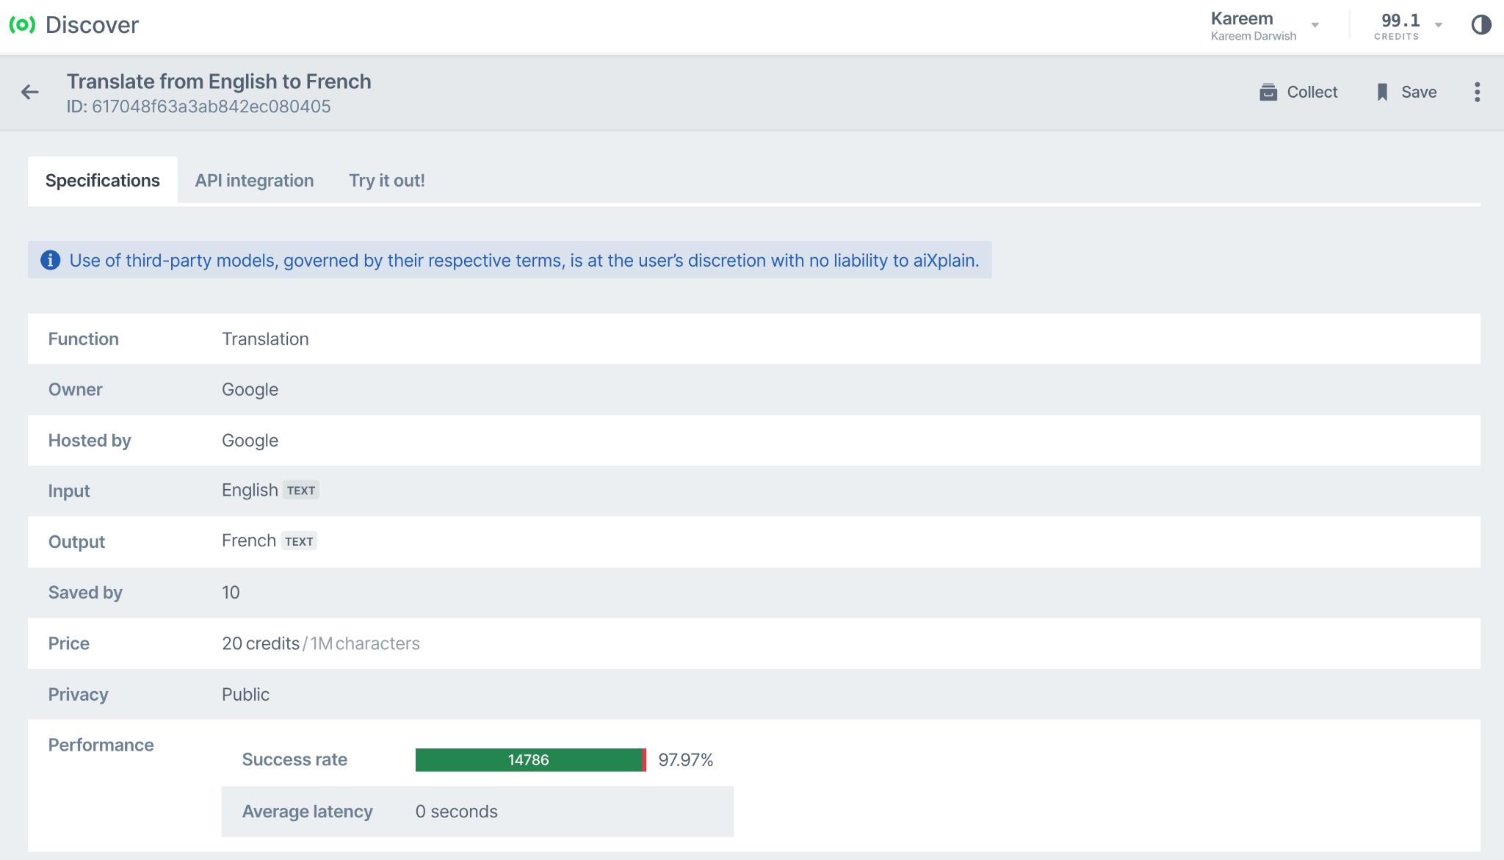
Platform Overview
Discover
Marketplace of 40,000+ AI assets
Open-source and proprietary
Dozens of different functions
Standardized API for ALL models

Slide 7
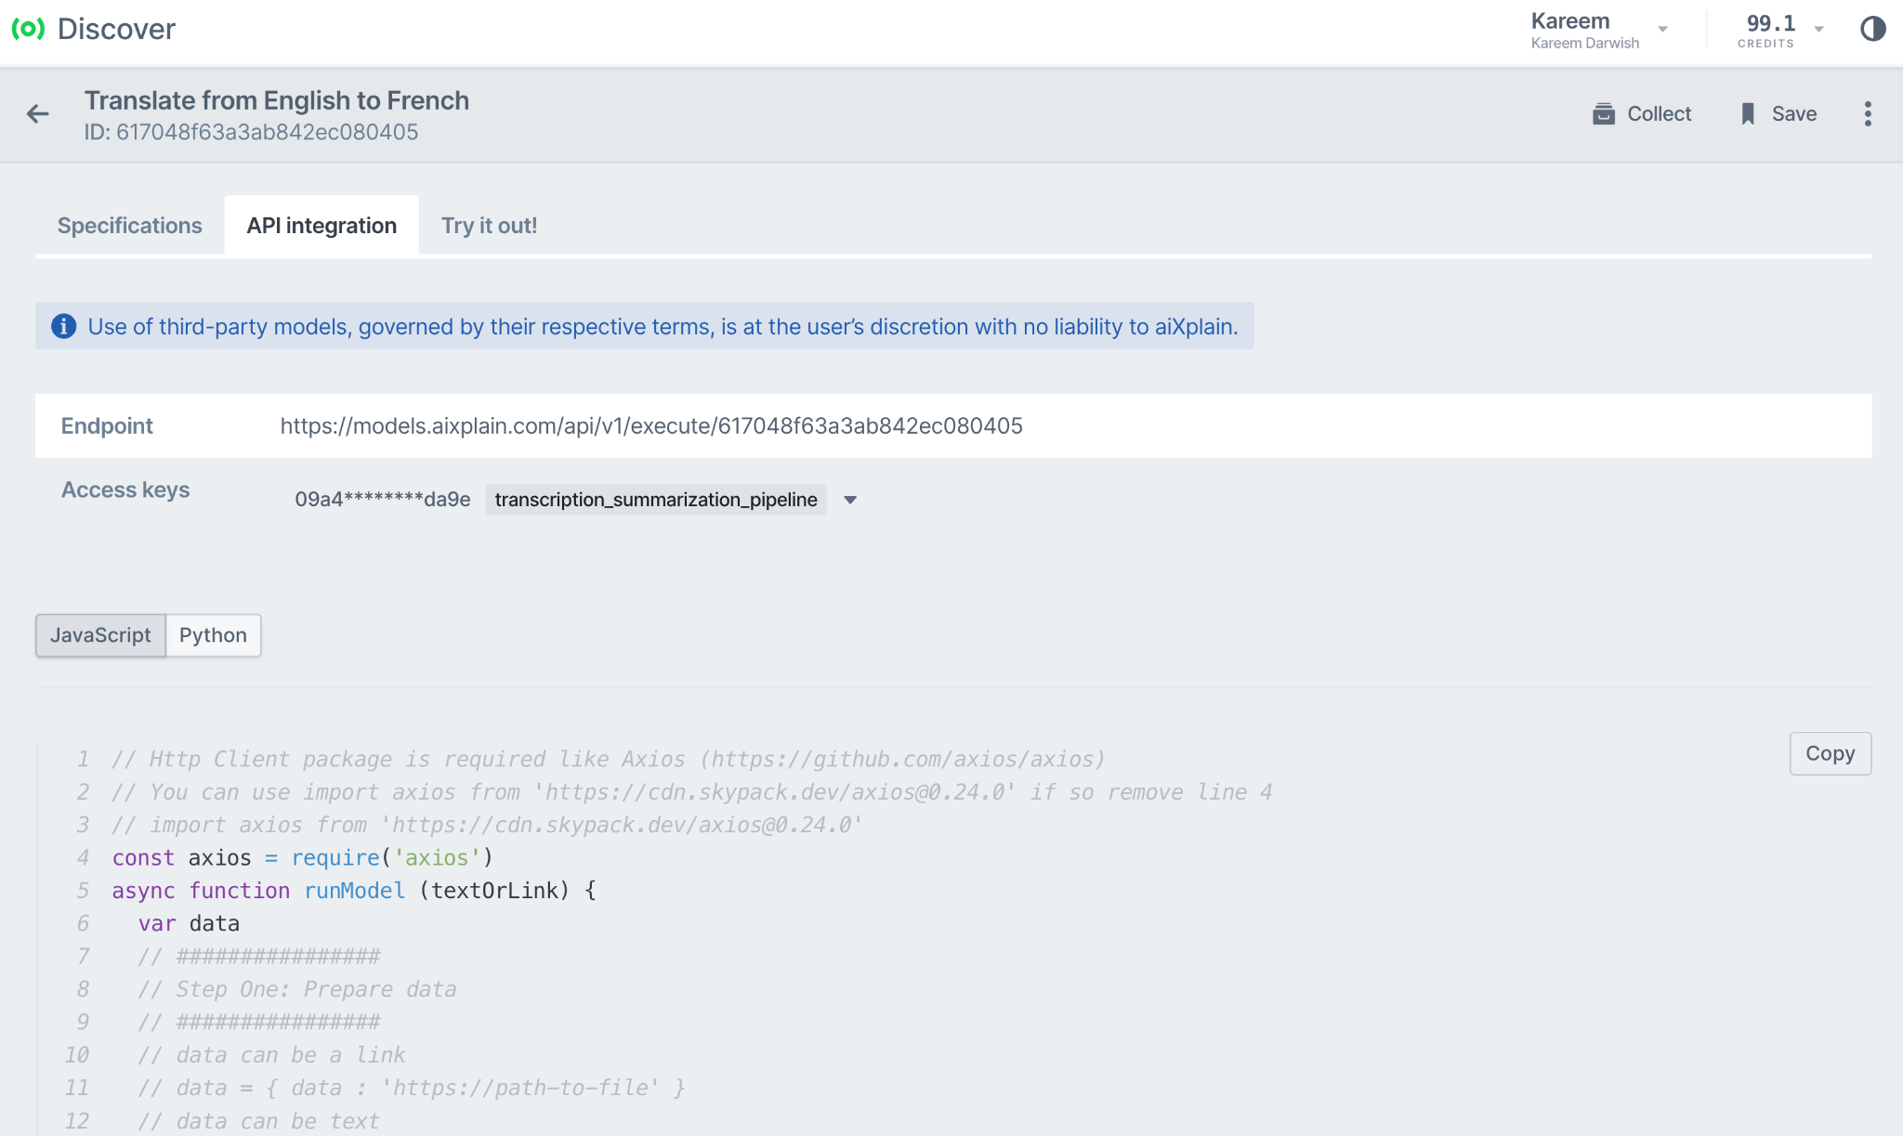
Platform Overview
Discover
Marketplace of 40,000+ AI assets
Open-source and proprietary
Dozens of different functions
Standardized API for ALL models

Slide 8
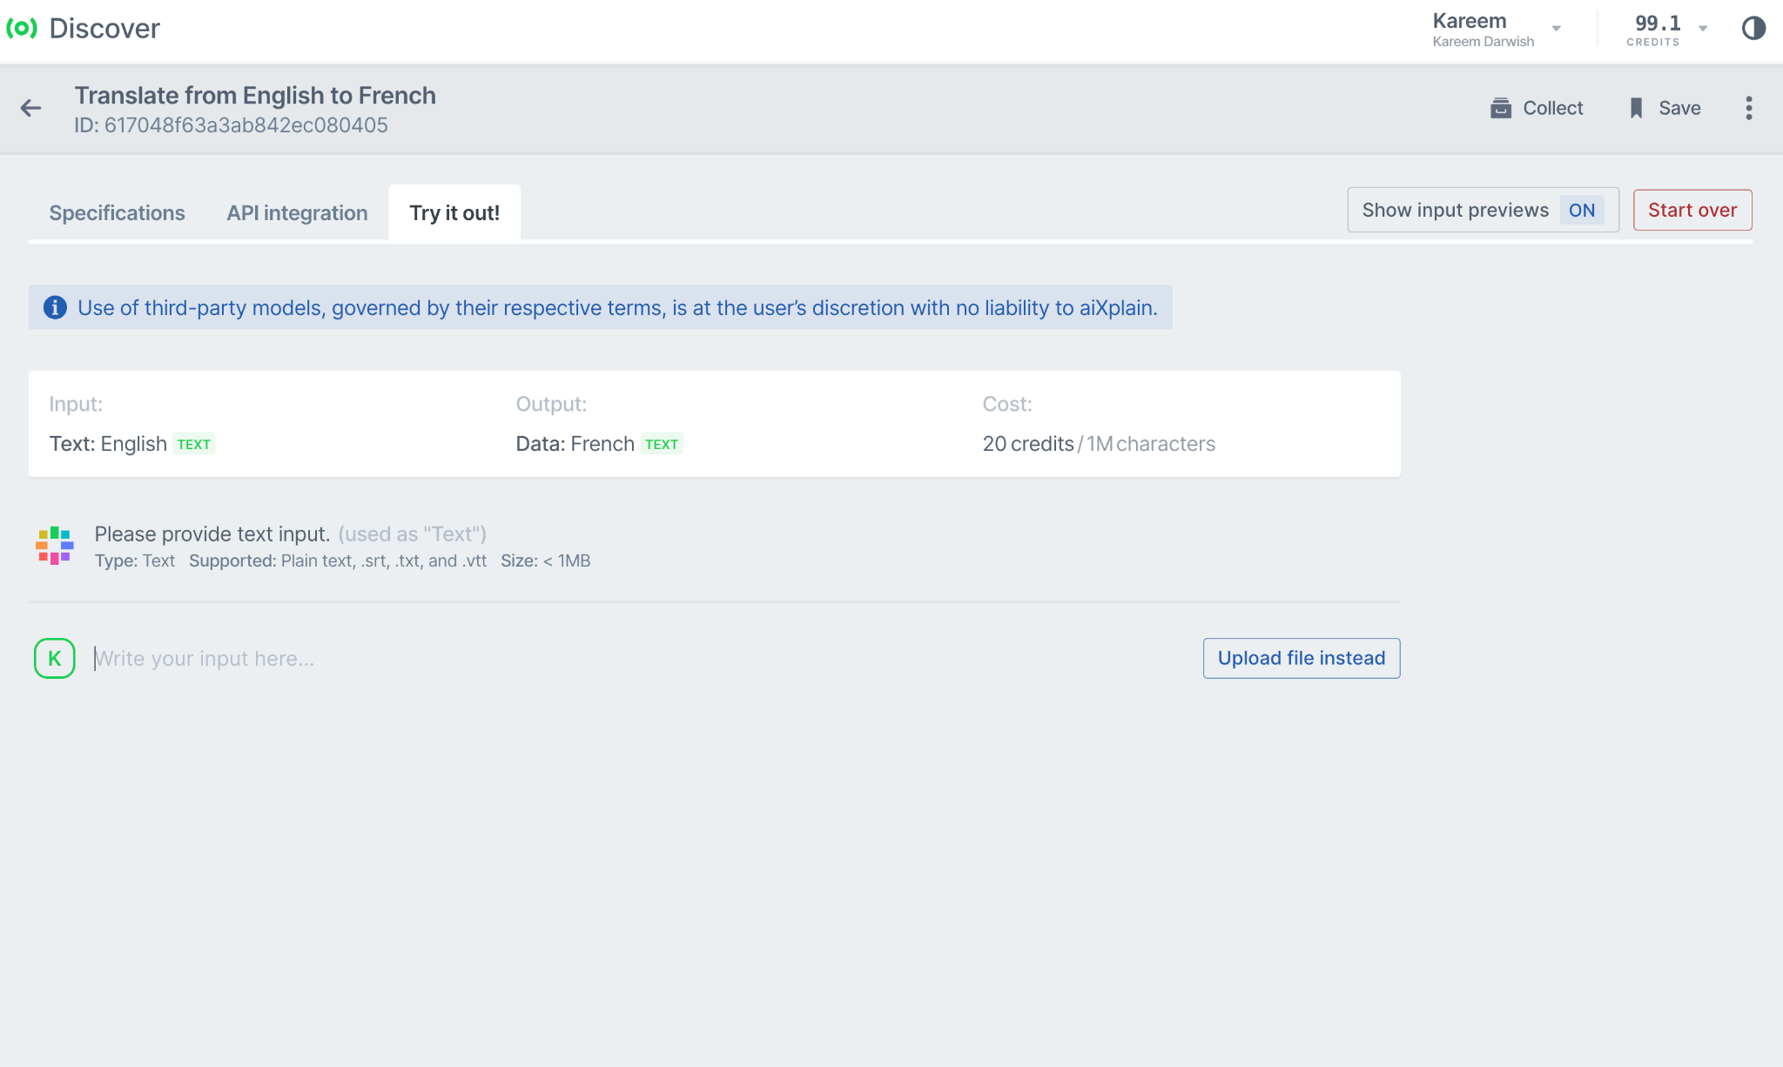
Platform Overview
Discover
Marketplace of 40,000+ AI assets
Open-source and proprietary
Dozens of different functions
Standardized API for ALL models

Slide 9
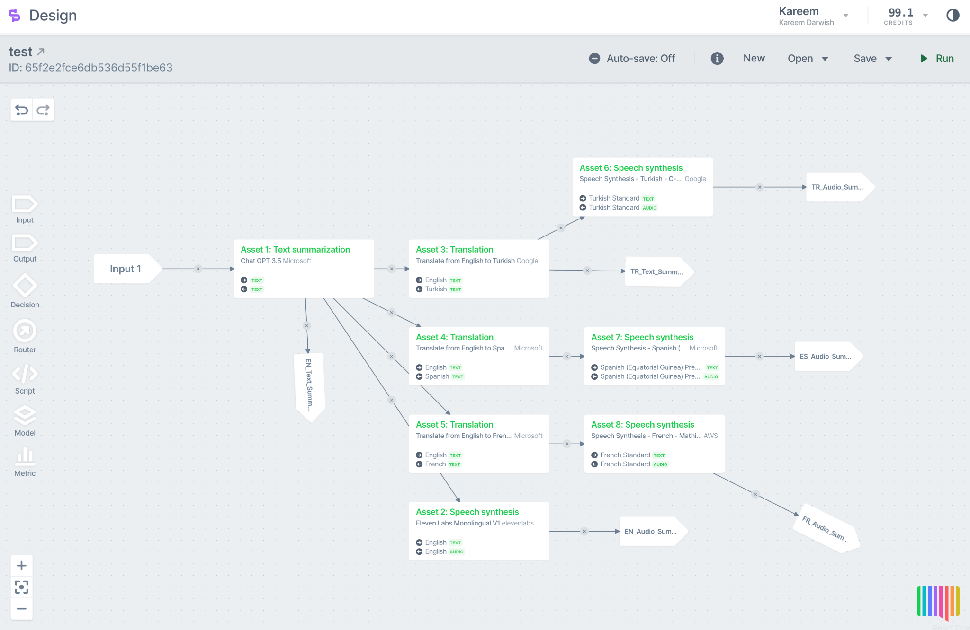
Platform Overview
Design
No-code/low-code AI solution building
Drag, Drop, and Connect
Deploy in minutes to a single API
Swap models inside a solution seamlessly
All models are standardized
All models can talk to each other

Slide 10
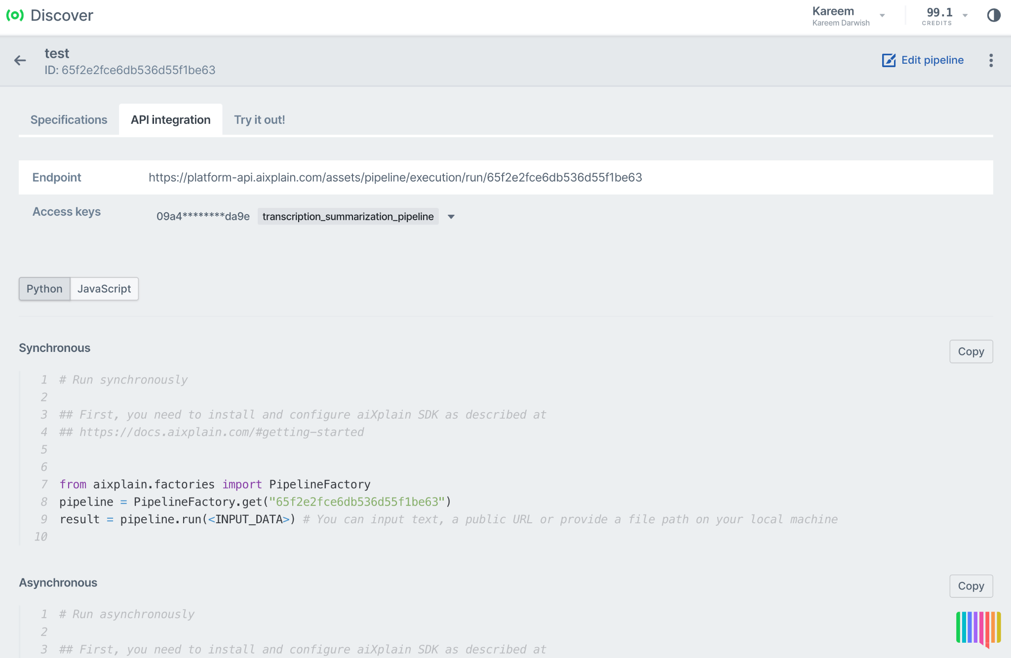
Platform Overview
Design
No-code/low-code AI solution building
Drag, Drop, and Connect
Deploy in minutes to a single API
Swap models inside a solution seamlessly
All models are standardized
All models can talk to each other

Slide 11
Challenges of entering the world of AI
Long development cycle
Can’t Keep up
1
2
There is currently a large overhead of AI development and deployment.
Being up-to-date with rapidly emerging AI technologies is nearly impossible.
Don’t know where to start
Not very adaptable
3
4
There is a gap between what AI is capable of and how to generate value through it.
Swapping or updating AI technologies in your solution is very tedious.
Hard to manage
No specialized talent
5
6
Different AI providers require different access, billing, and integration.
As it’s a relatively new field, there is a shortage of talent to meet the very high demand.

Slide 12
How aiXplain addresses these challenges
Shortest path from idea to production
Open marketplace
Proof of concept in minutes, live tailored solution in days.
Access 40,000+ proprietary and open-source AI models, including best-in-class LLMs.
Quick deployment, seamless integration
Adaptable solutions
Standardized APIs allow swapping models with zero friction
AI solution via a single and easily accessible API
Centralized solution management
No AI or coding expertise required
Manage the access, billing, and integration in one place
Build and deploy AI solutions without writing a single line of code.

Slide 13
Who does aiXplain empower?
Innovators
Enterprises
AI providers
Power Users
Transform your ideas into AI solutions, in minutes. Effortless, no coding, just instant results.
Executives and Decision Makers
Discover scalable AI solutions tailored to meet your business needs.
Commercial suppliers
Expand the reach of your AI data, models, and services to an AI-hungry market.
Product Managers
Enrich your product with AI and build proofs of concept in minutes.
Tech Enthusiasts
Develop AI solutions for your projects through aiXplain’s integrated development platform.
AI developers
Host, sell, and scale your AI value without being affiliated to an organization.
Development teams
Collaborate on AI projects in one secure shared environment with all the AI assets and tools you need.

Slide 14
Thank you.
Kareem Darwish
Principal Scientist
kareem.darwish@aixplain.com

