Slide 1
Reinforcement Learning
Next Step in Applied Machine Learning Revolution
Assoc. Prof. Nazim Kemal Ure
Artificial Intelligence and Data Science
Applied Research Center
AI.ITU.EDU.TR

Slide 2
Short Bio
Prof. Nazim Kemal Ure
PhD@ MIT, 2015, Aero/Astro
Professor of AI and Data Eng. @ Istanbul Technical University (ITU), Since 2015
Main Research Areas:
Deep Reinforcement Learning
Autonomous Systems
Large-Scale Optimization
ITU Artificial Intelligience and Data Science Research Center
Founded in 2018
Research center focusing on both fundamental and applied AI research

Slide 3
Introduction

Slide 4
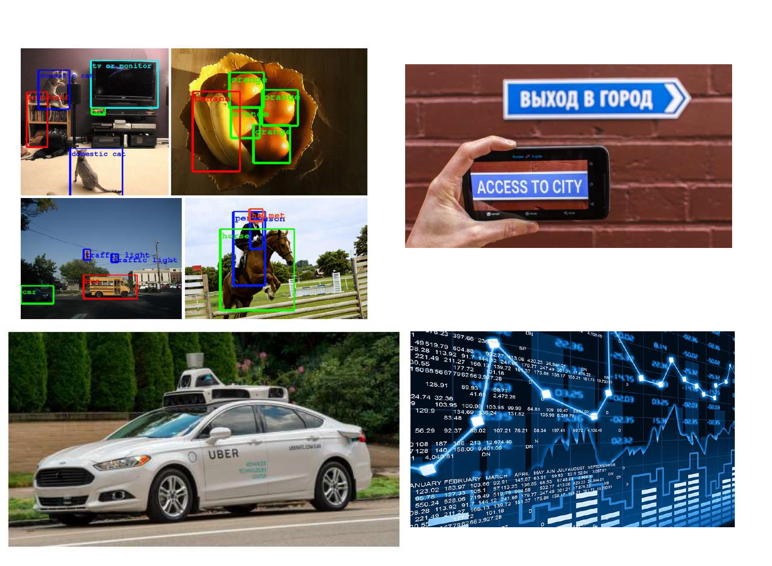
ML Revolution
Modern machine learning revolutionized how we process data.
AI/ML is not a niche academic subject anymore, it is at the heart of many applications.
What is the next step in adoption of advanced ML methods in industry?

Slide 5
Supervised Learning
Machine Learning
Model
Data
Text, Images, Tables etc.
Predictions
Forecasts,
sentiment,
faults,
next action etc.
Covers ~90% of current industrial applications
Not useful on its own

Slide 6
Imitation Learning (Behaviour Cloning)
Machine Learning
Model
Data
Text, Images, Tables,
etc.
Decisions
Actuation,
Allocation,
Targeting,
etc.
Covers ~10% of current industrial applications
Much more useful than classical supervised learning
Performance is strictly limited by training data

Slide 7
Reinforcement Learning
Machine Learning
Model
Data
Text, Images, Tables,
etc.
Decisions
Actuation,
Allocation,
Targeting,
etc.
The World
Update Data
Execute
Huge potential in industry
Still in the early adoption stages

Slide 8
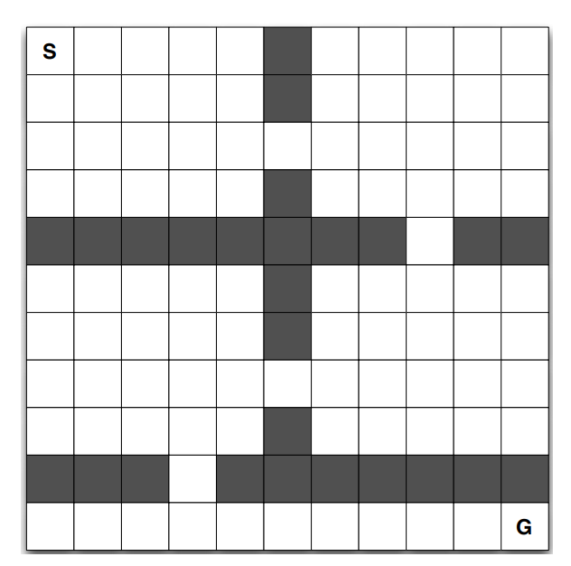
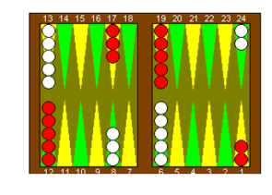
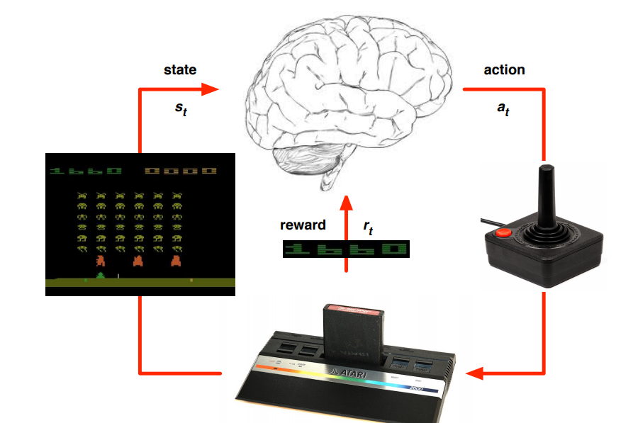
Brief History of RL
1980s-1990s
Dark ages
2000s-2010
Limited to small-medium scale problems
2010-2017
Impressive demonstrations on games and controlled environments
2018 – Now
Slow adoption by the industry

Slide 9
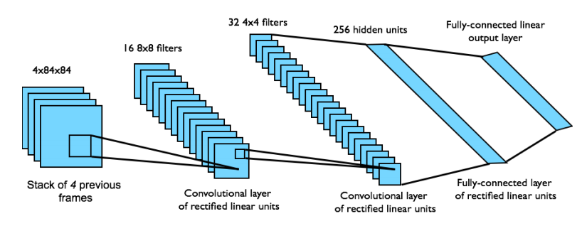
Deep Reinforcement Learning
Google Deep Mind Breakthrough
at 2014

Slide 10
Deep Learning
Ref: Levine

Slide 11
Deep Reinforcement Learning
Ref: Levine

Slide 12
Deep Reinforcement Learning
Ref: Levine

Slide 13
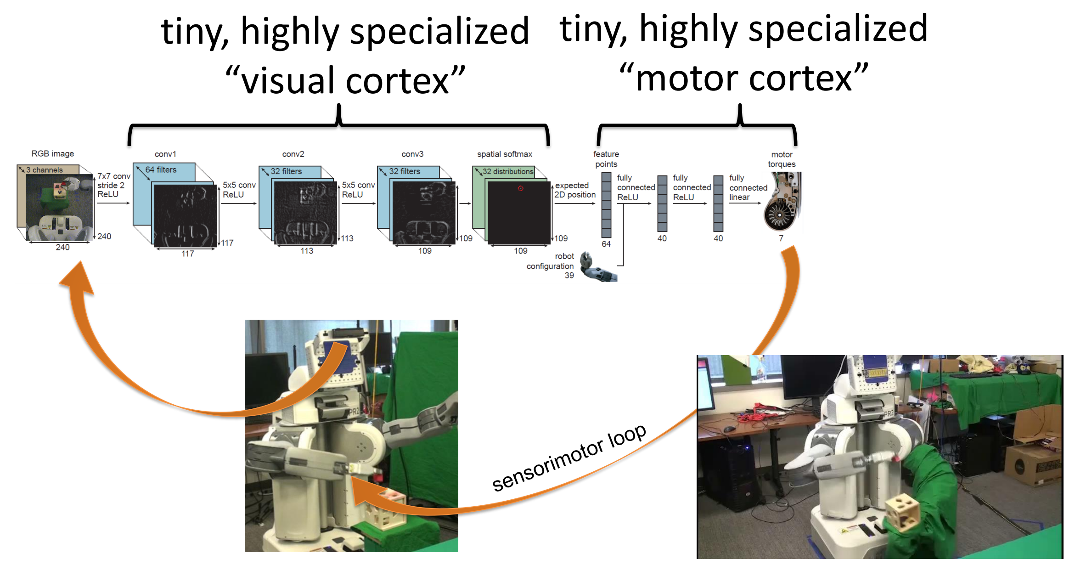
Deep Reinforcement Learning
Ref: Levine

Slide 14
Applications

Slide 15
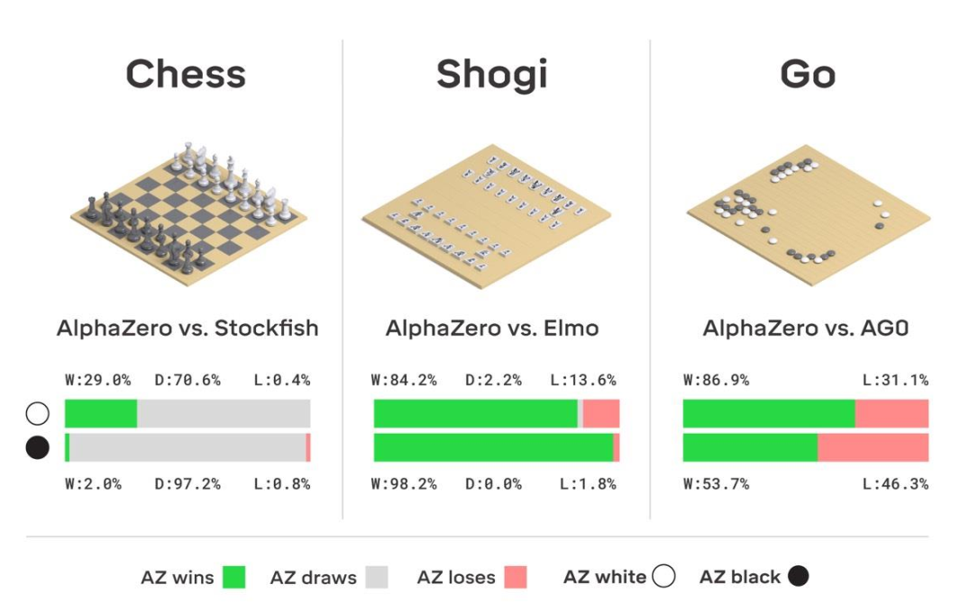
Games
Ref: DeepMind

Slide 16
Games
Ref: Jung, Youtube channel

Slide 17
Games
Ref: Google AI

Slide 18
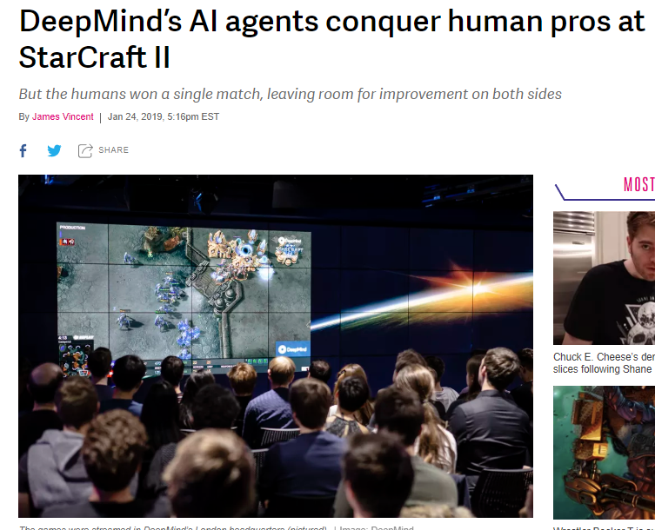
Games

Slide 19
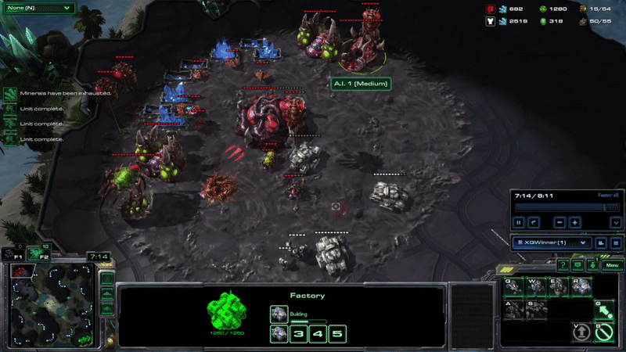
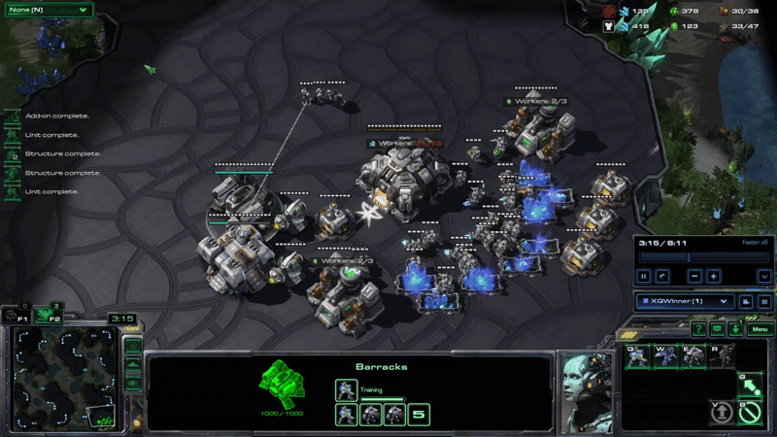
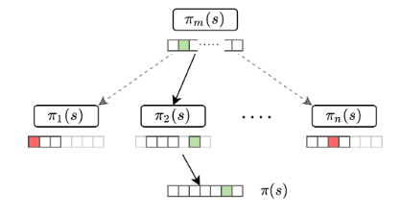
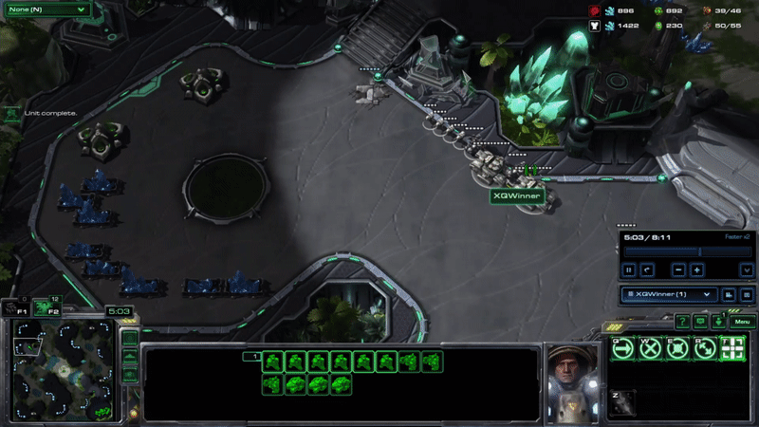
Games
Ref: ITU AI (Supported by ASELSAN)

Slide 20
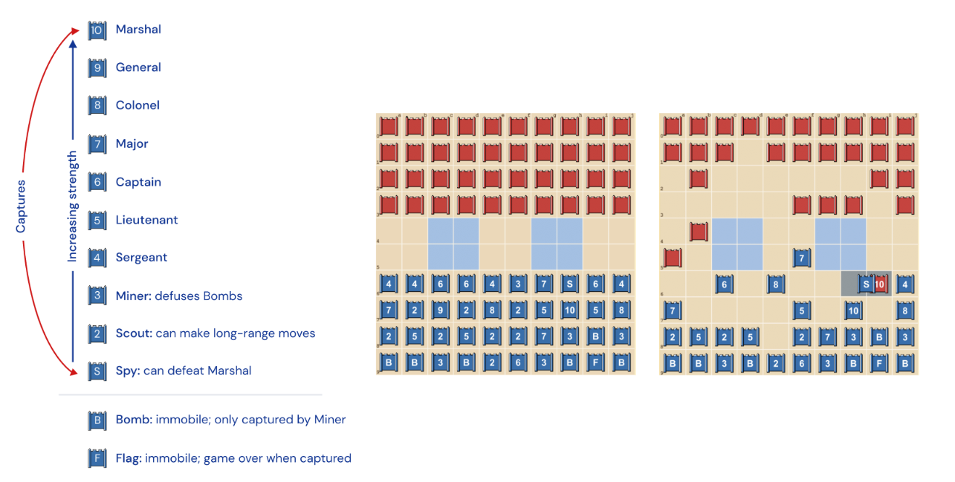
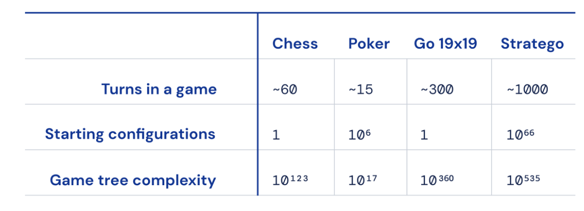
Games
Ref: DeepMind

Slide 21
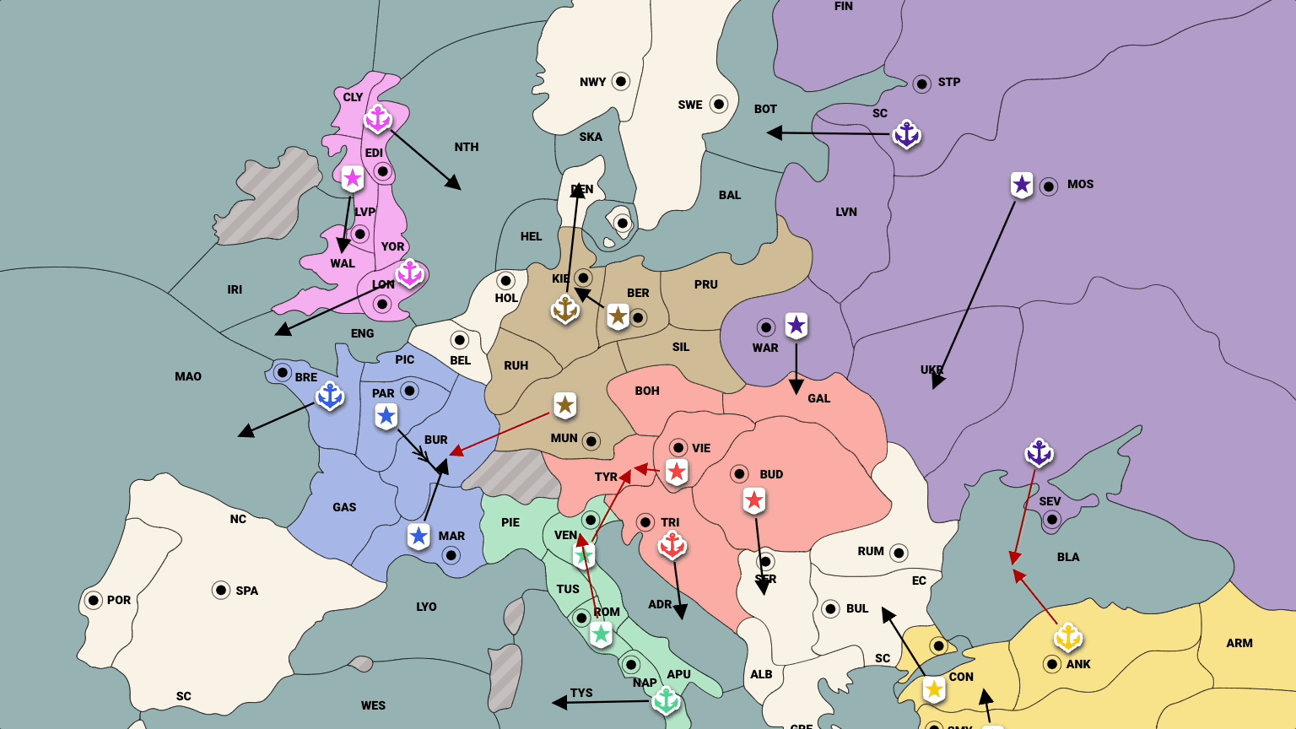
Games
Ref: Meta AI

Slide 22
Games
Ref: Sony AI

Slide 23
Robotics
Ref: Google AI

Slide 24
Robotics
Ref: Open AI

Slide 25
Robotics
Ref: DeepMind

Slide 26
Robotics
Ref: Berkeley

Slide 27
Autonomous Systems
Ref: MIT

Slide 28
Robotics/Autonomous Systems
Ref: ITU AI and Eatron Technologies

Slide 29
Autonomous Systems
Ref: MIT

Slide 30
Autonomous Systems
Ref: MIT

Slide 31
Autonomous Systems
Ref: UZH

Slide 32
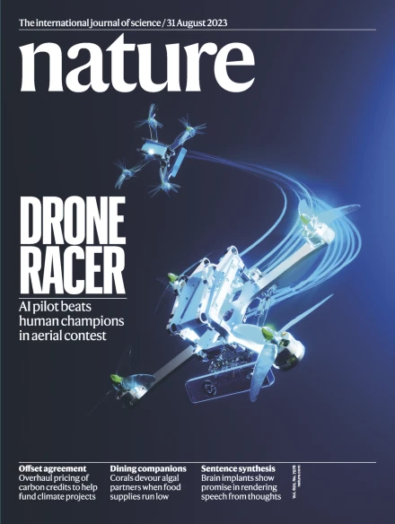
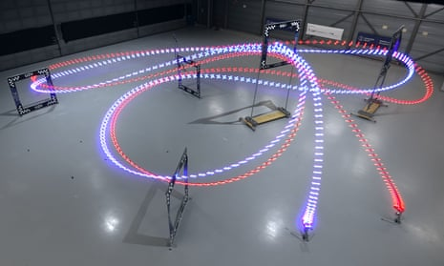
Robotics/Autonomous Systems
Ref: University of Zurich

Slide 33
Autonomous Systems
Ref: Stanford

Slide 34
Autonomous Systems
Ref: ITU AI (Supported by TAI)

Slide 35
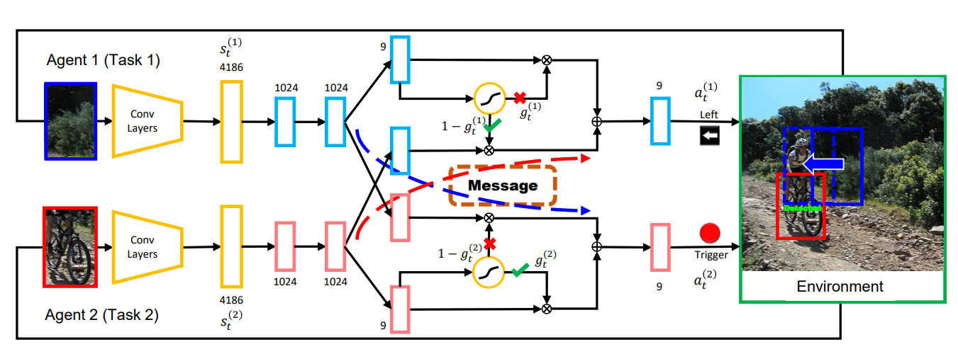
Computer Vision

Slide 36
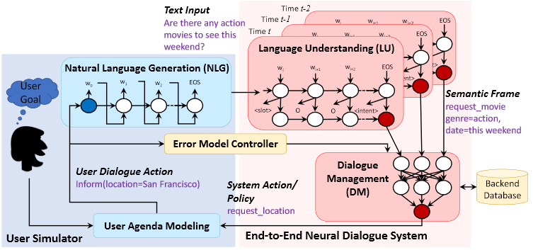
Natural Language Processing/Generation
Ref: Meta AI

Slide 37
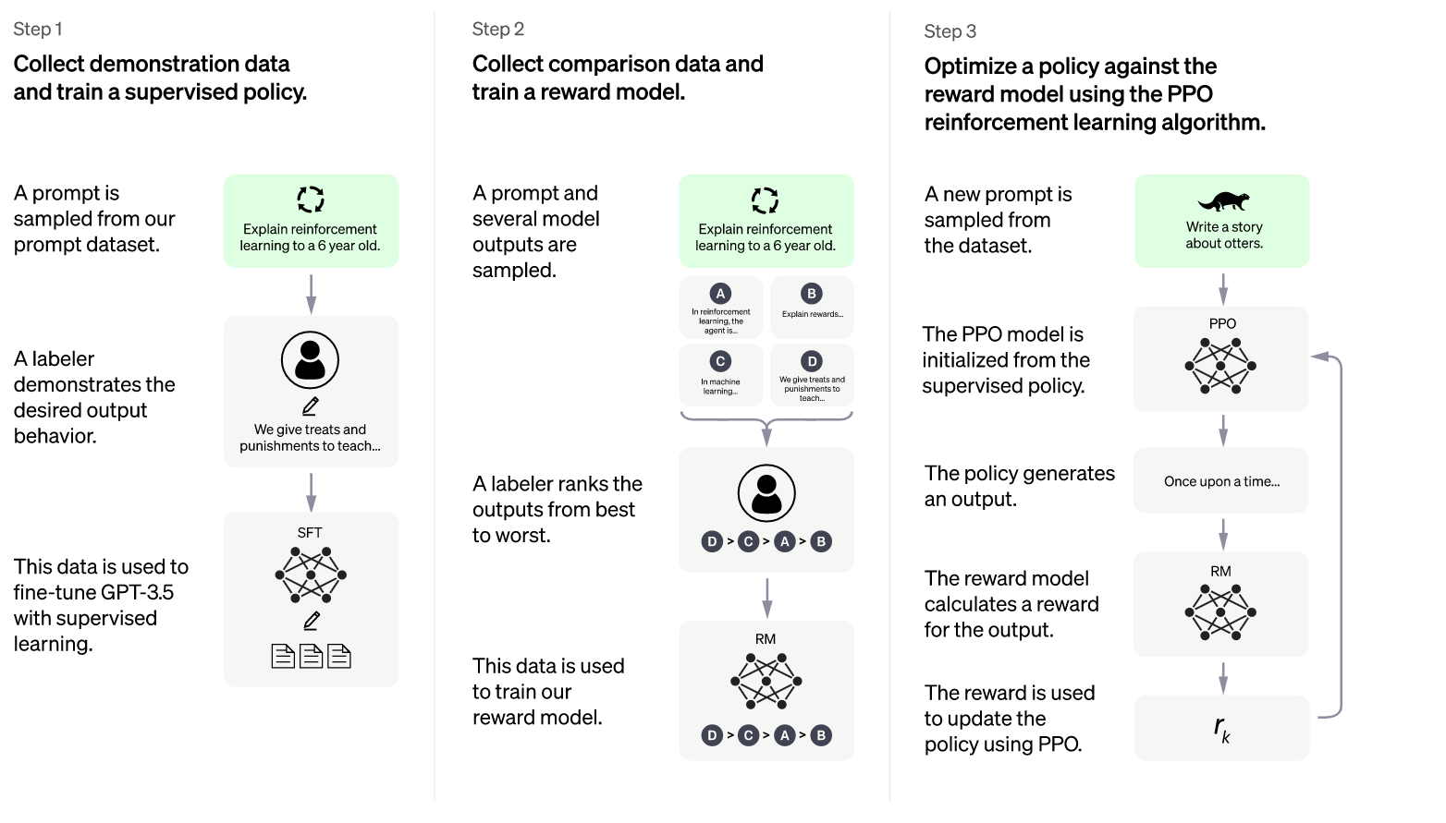
Natural Language Processing/Generation
Ref: Open AI

Slide 38
Mathematics
Ref: DeepMind

Slide 39
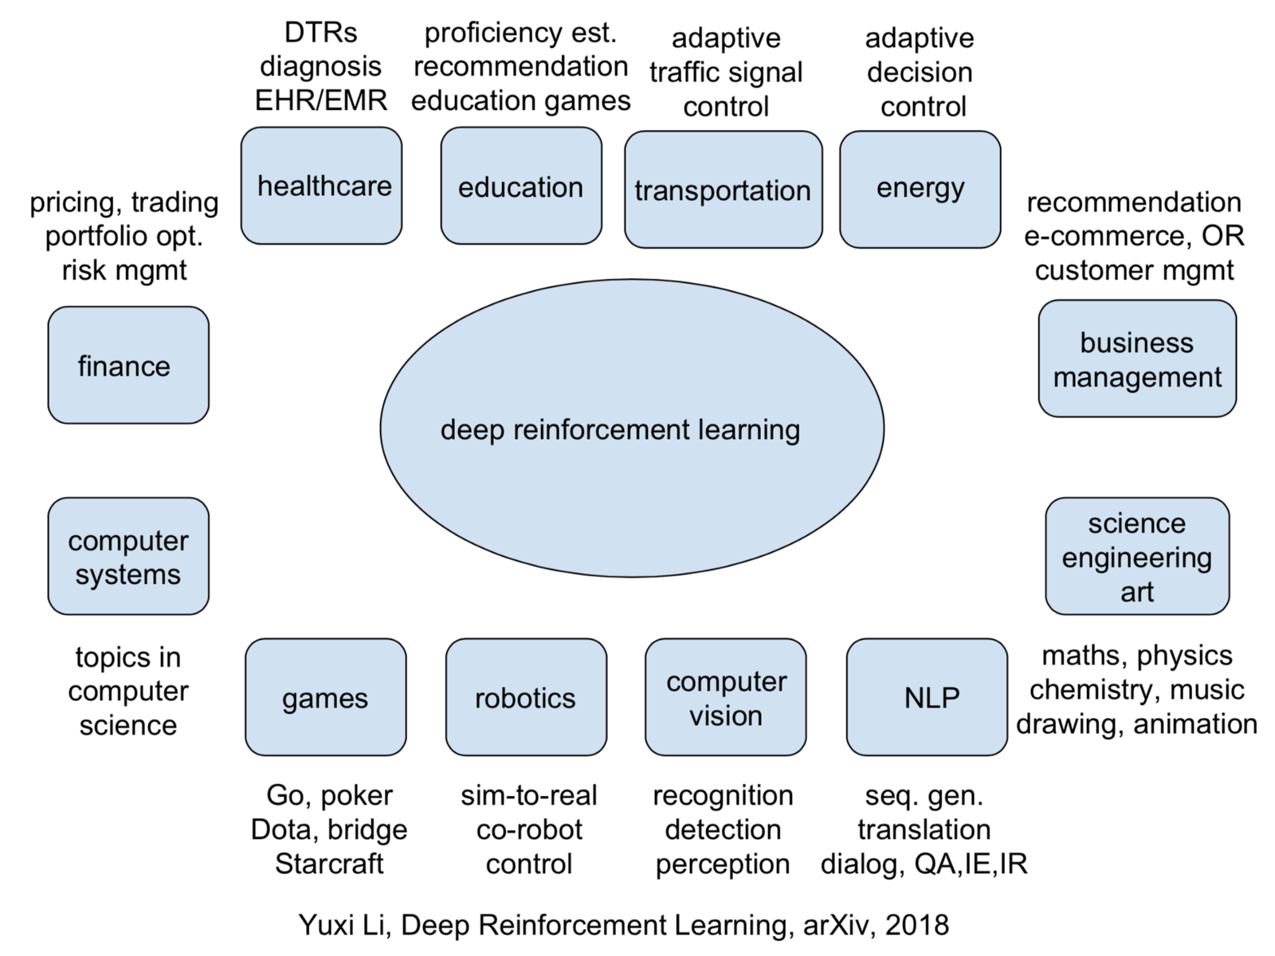
Many, many other examples
Other notable applications
Finance
Algo Trading, Portfolio Management
Energy
Storage/Production Management
Operations Research
Crew planning, logistics and planning

Slide 40
Conclusion and The Future
RL unlocks/enables a wide array of applications
However, there are still key problems we need to tackle to increase adoption rate
Scalability
Generalization
Simulation Gap
Safety/Trustworthiness
Large number of companies/universities are working on these key challenges.

Slide 41
THANKS
AI.ITU.EDU.TR

